Slide 1
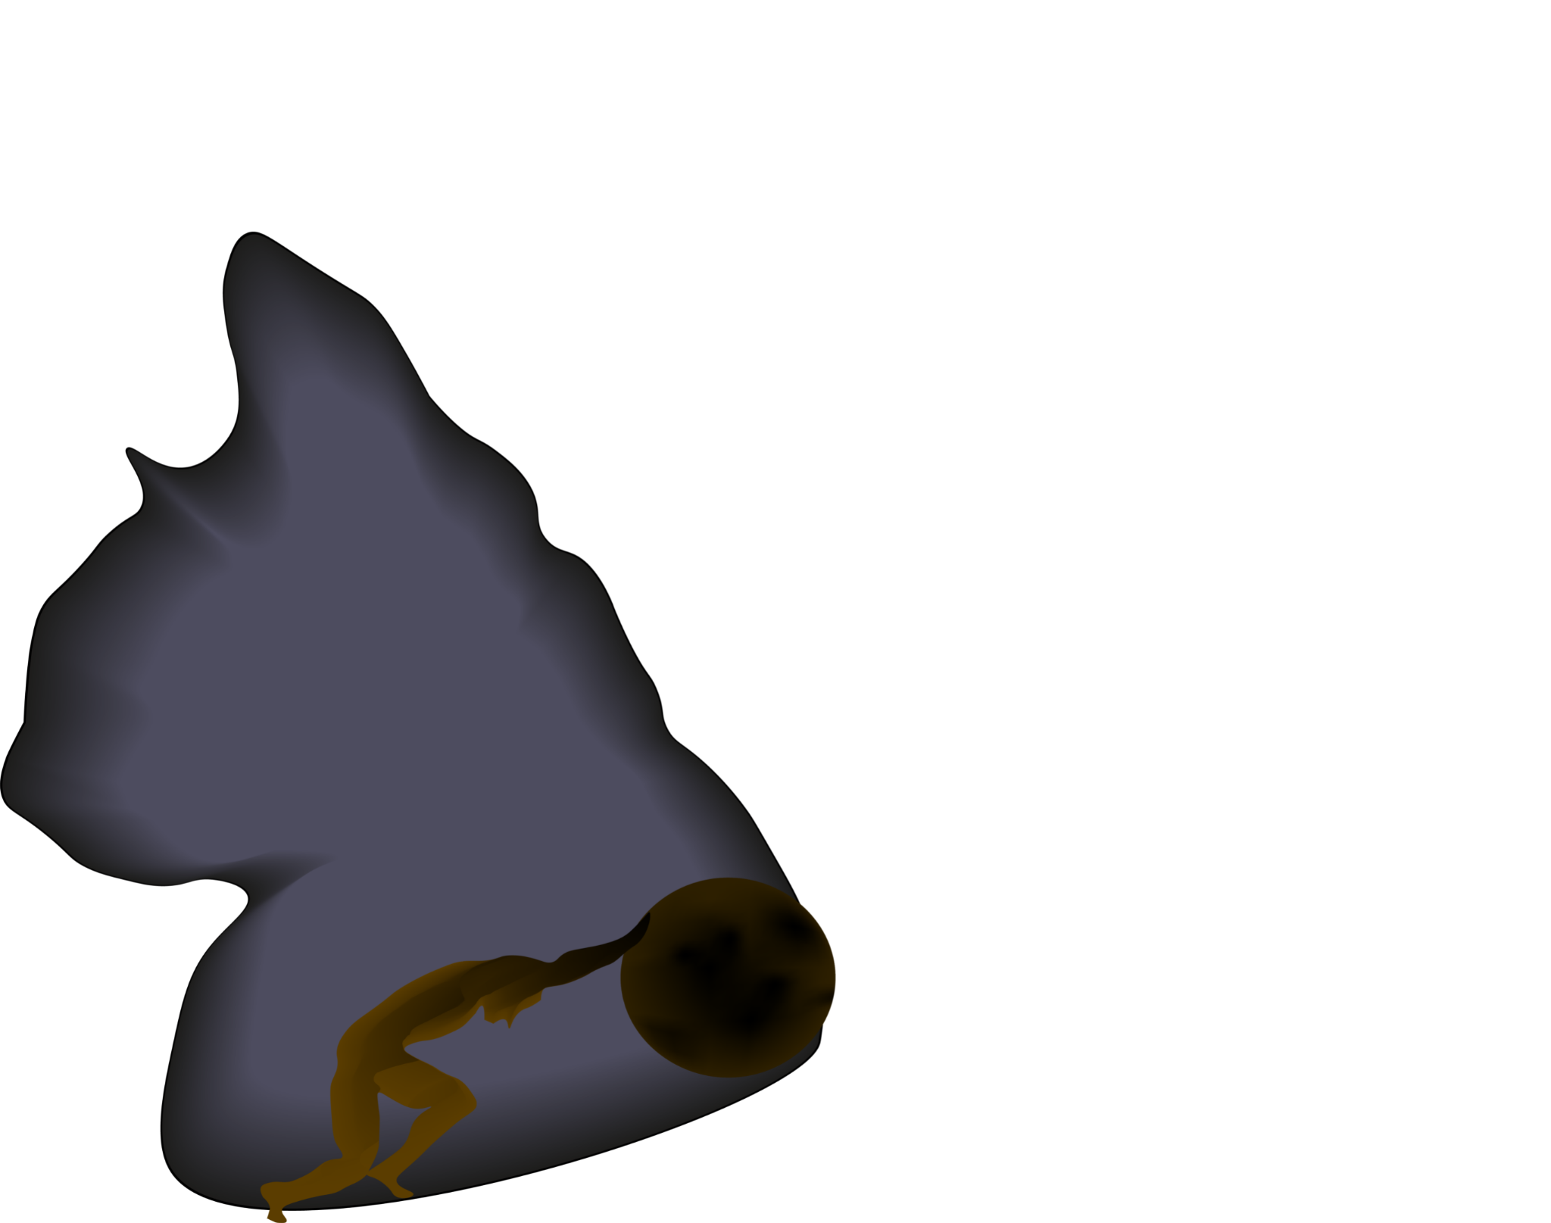
Sisyphii
Pet Platform

Slide 2
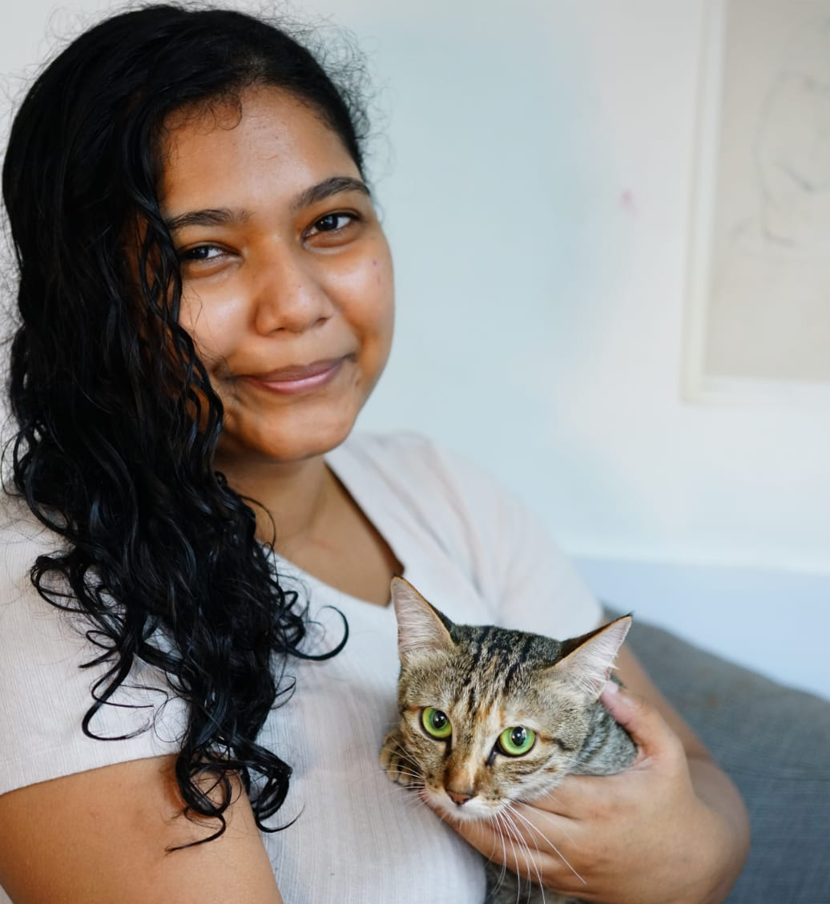


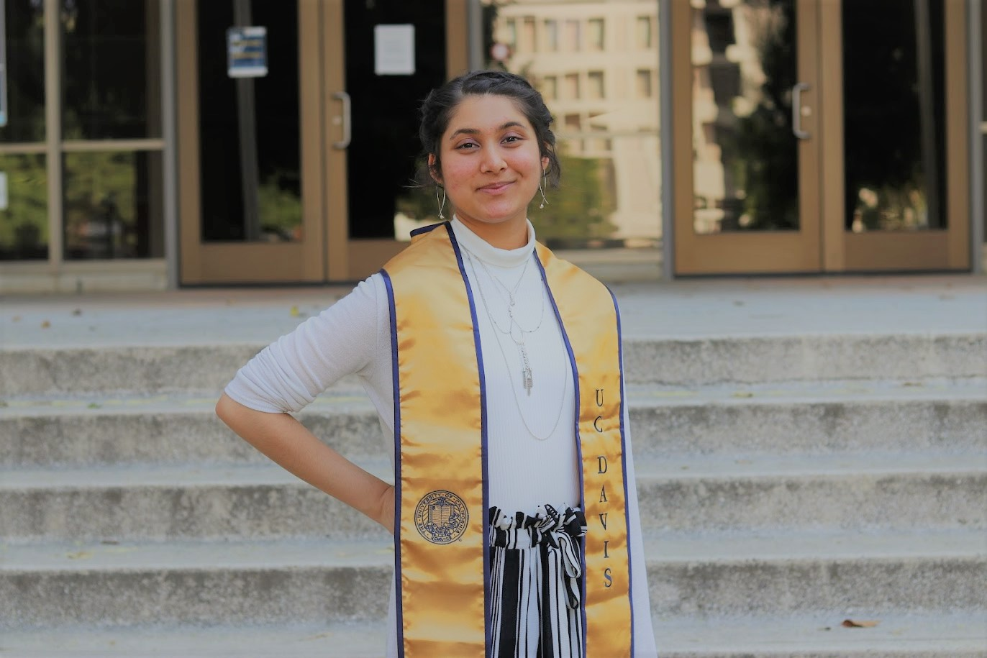

NIDHI Mahejabeen Hossain
Project Manager
Data Engineer
DevOps
CHAN Ka Lok, Andrew
Experienced Developer
Blockchain Developer
YEUNG Man Kit, Nick
Full-stack Developer
RAZA Ziqra Ishfaq
International Business & policy
Cybersecurity
NGO Experience
KIM Jeanyoung Jennifer
Engineering Management
Marketing & Financial Manager
Notes:
Andrew - experienced developer with an interest in blockchain
Kit - full stack developer
Nidhi - project manager, data engineer, DevOps
Jennifer - marketing and financials
Ziqra - International business, policy, cybersecurity, NGO experience

Slide 3
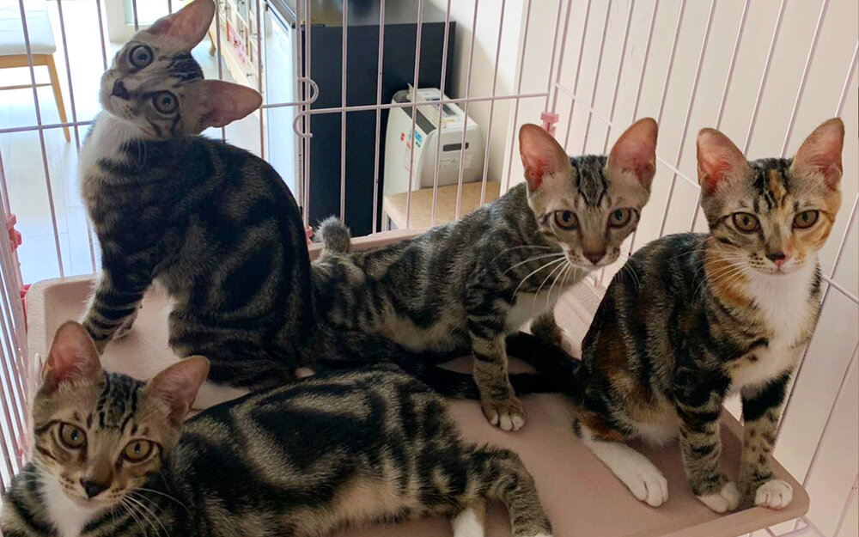
Current Challenges
Urgent need for reliable fosters for animals in critical conditions
Unable to easily track animals
Heavily reliant on social media for resources
Lack of accessibility to vet records
No system in place to record pet data
No app covering a broad range of pet services
No system to share medical records
Only few practices have online booking
Very minimal tele-veterinary services are available
Animal Charities
Pet Owners
Veterinary Practices
Notes:
Often urgent fosters are needed due to animals being found in critical conditions
Pet owners do not have accessible e-records of their pets from veterinary clinics
Charities are not able to easily track if/when a foster took a pet to a partnered vet
Heavy reliance on social media for donations

Slide 4

Distributed Database
Store valuable data about available fosters/adopters
Experience in animal care and special care (e.g. bottle-feeding)
Blacklisted animal abusers
Allow relevant parties to log pet behavior/symptoms for animal welfare
Easily accessible veterinary records to aid in better diagnosis

Slide 5

Application Features
Tele-veterinary care
Important reminders for carers
Medication/Vaccinations
Vet appointments
Online booking of vet/pet care services
Optimise resource distribution
Data recording and analysis to understand underlying trends of animal health

Slide 6
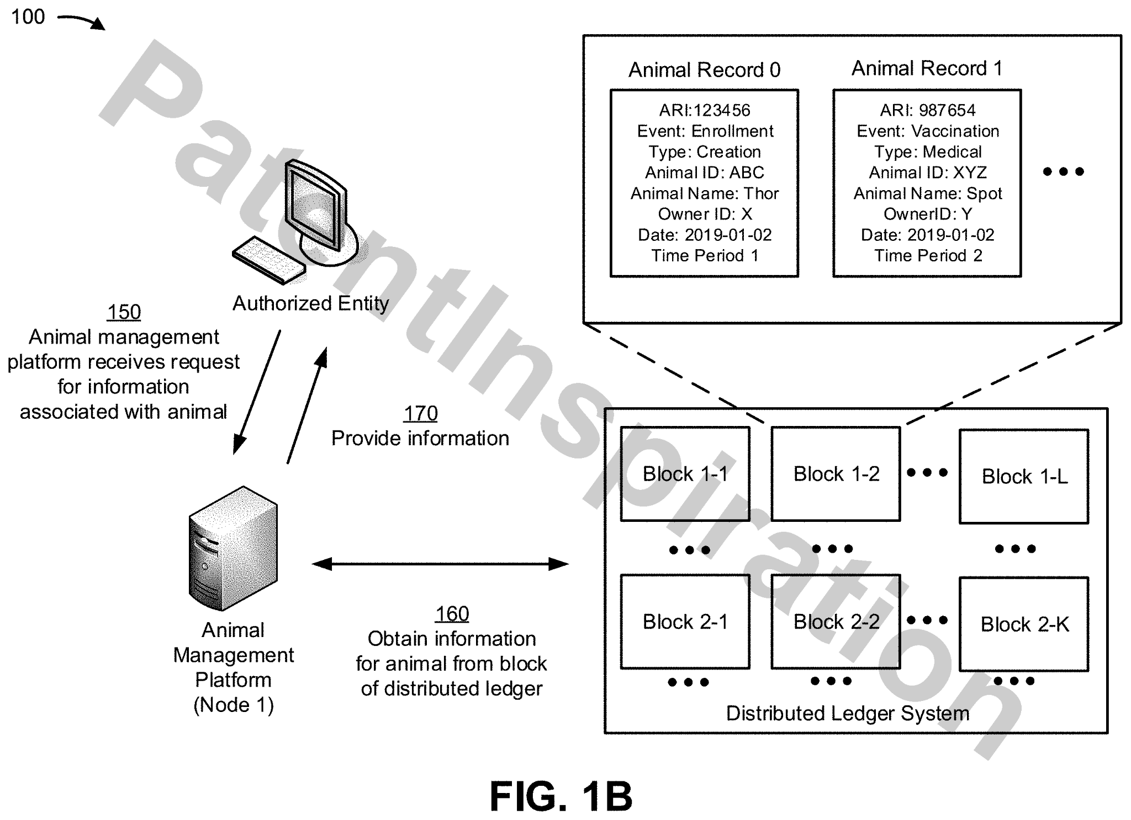

Related Tech
CN111199052A US2020159720A1 Distributed system for animal identification and management 26 May 2020 ACCENTURE GLOBAL SOLUTIONS LTD
US2020313852A1 Consent-based data management 1 Oct 2020 IBM
KR102209299B1 System and method for pet registration using blockchain 28 Jan 2021 HAN SU YEON
KR20190098077A Method and system for providing blockchain based pet-care service

Slide 7

Development
In process of contacting more vets and charities
Designing a WebApp with Angular
Creating a database with postgreSQL
Creating a smart contract system
Implementing payment methods

Slide 8
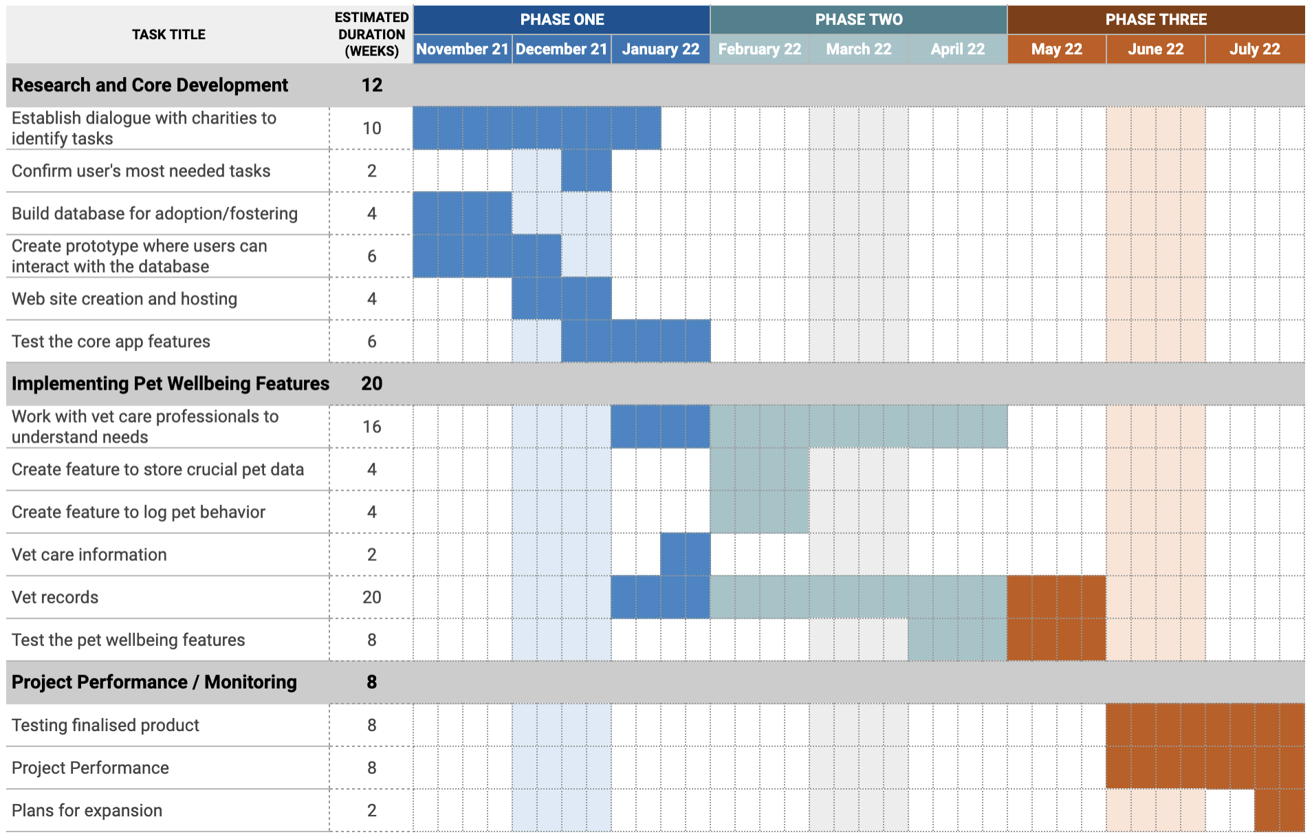

Slide 9
THANK YOU
Imagine Sisyphus Happy

Slide 10
Appendix

Slide 11
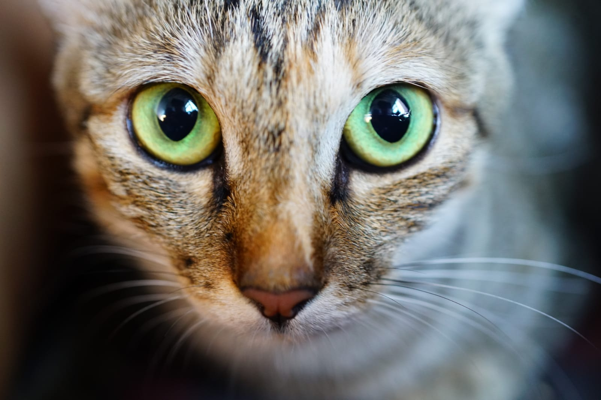
Sisyphii’s Vision
Creating a platform that empowers animals, adoption centers, and pet owners by utilizing data, blockchain, and AI.

Slide 12
Goals and Objectives of Sisyphii
Empower charities and animals
Connect animals with adopters and fosters
Create a transparent environment
Hold people accountable for the animals under their care

Slide 13
Why Blockchain?
Charities, veterinary practices, and pet owners can rest assured their data is secure
Blockchain supports immutability so important data, such as blacklist, cannot be easy tampered
Transparency and trust is vital for such a emotive field
Sponsors and donors can see the impact of their support

Slide 14
Revenue model
Earn from setting up the system in veterinary practices
Minimal monthly payment for shelters to pay to use the system
Pet owners can subscribe for premium services such as tele-veterinary care
Earn from pet service providers who want to reach a bigger audience

Slide 15

Pet Services
Generate revenue through advertisements of integrated pet services such as:
Pet sitting
Pet hotels
Dog walking
Funeral services
Grooming
Pet behavioral training
Subscription boxes with pet essentials

Slide 16
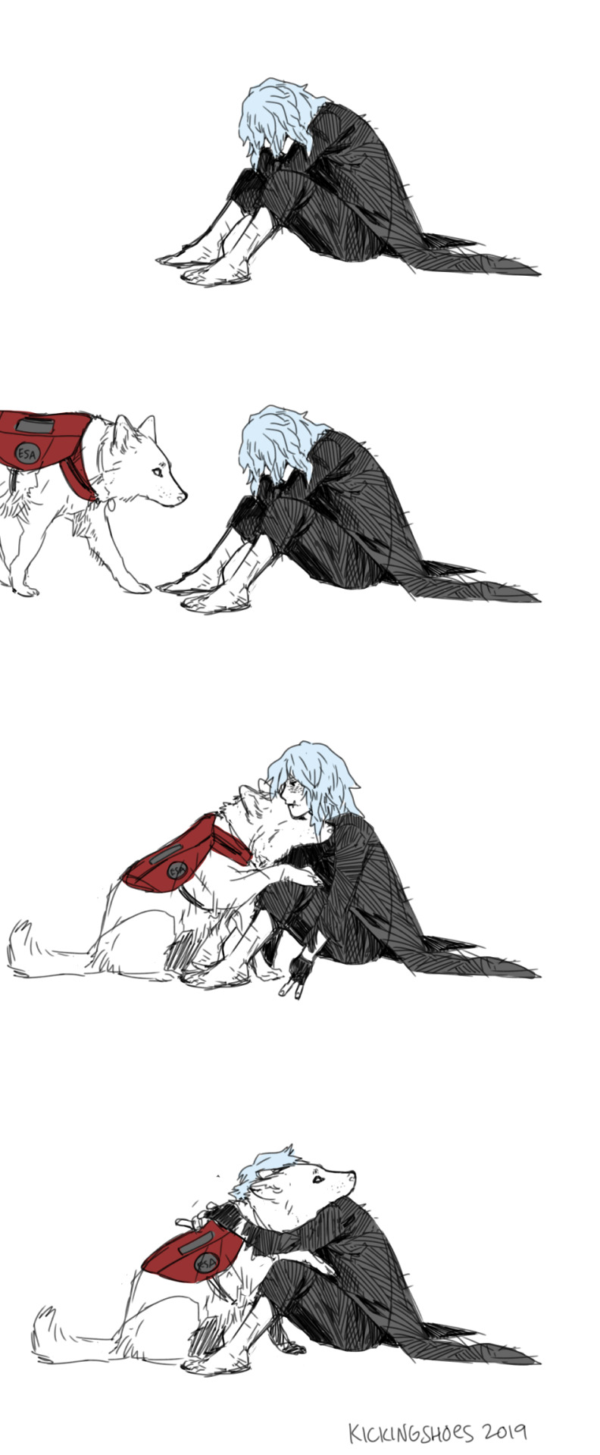
Social Welfare Programs
Promote Sisyphii while initiating social welfare events such as:
Guide dogs for the blind
Emotional support animals
Animal care trainings

Slide 17
Competitive Advantages of Sisyphii
Enables collaboration between charities, veterinary practices, and pet owners
Brings together key features for pet wellbeing for all stakeholders involved
Intuitive design plans so stakeholders do not have to spend on costly training programs
Modular features so that integrating it into existing systems easier

Slide 18









Competitor Analysis
Features
Connectivity between stakeholders

Slide 19

Budget Plans
Application development
Integration with other services
Hosting web application
Marketing
Training events
Social welfare events

Slide 20
Expansion Opportunities
Computer vision to ensure pet safety measures are adequate
Enforce use of app for every pet owner, even if they purchased and not adopted, so that trends of the welfare of the animals coming from a shop/mill can be closely observed for possible cruelty
Improve overall health by reducing stray animals
Work closely with veterinary researchers and adapt to better care for animals
Charities will be able to create custom NFTs to attract sponsors for the animal in need
Build a metaverse for the helped pets

